Slide 1
What is LangChain?

Slide 2
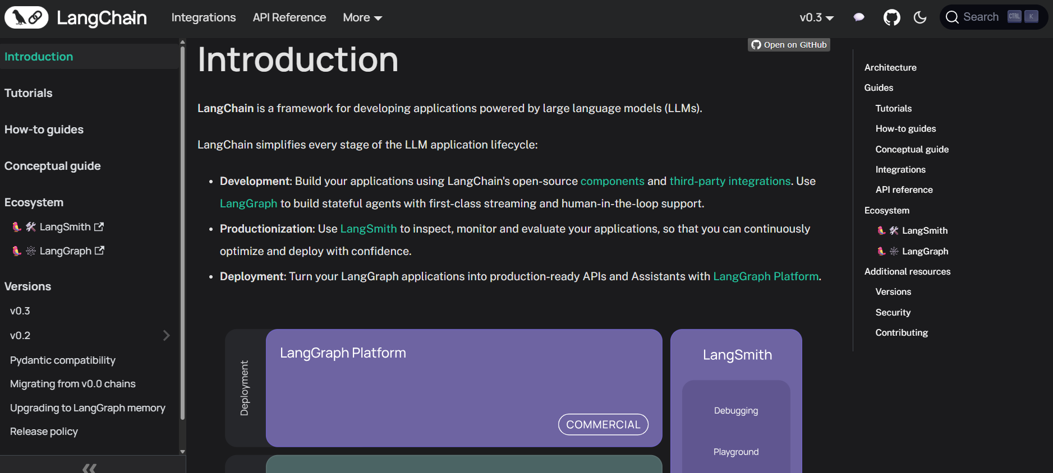

Slide 3
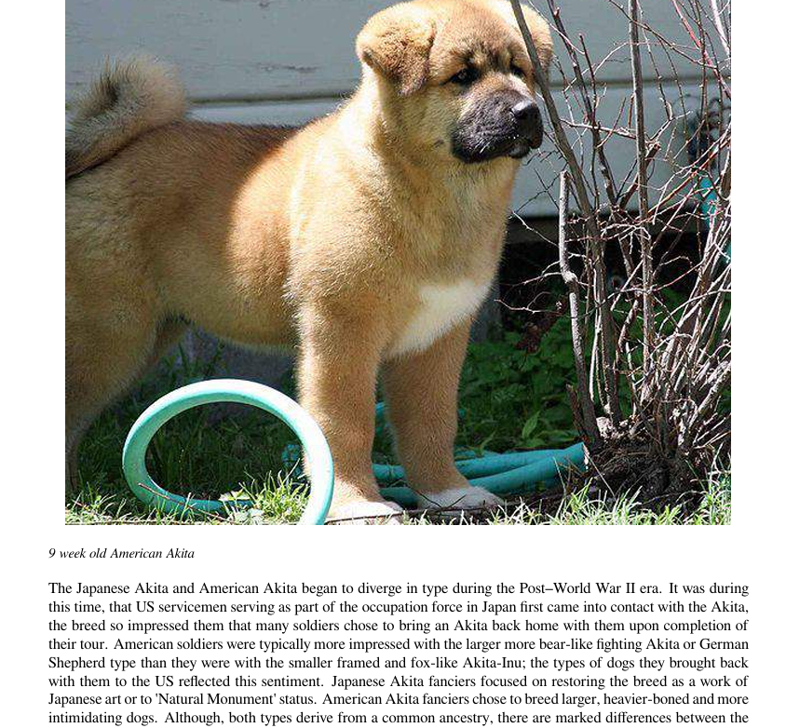

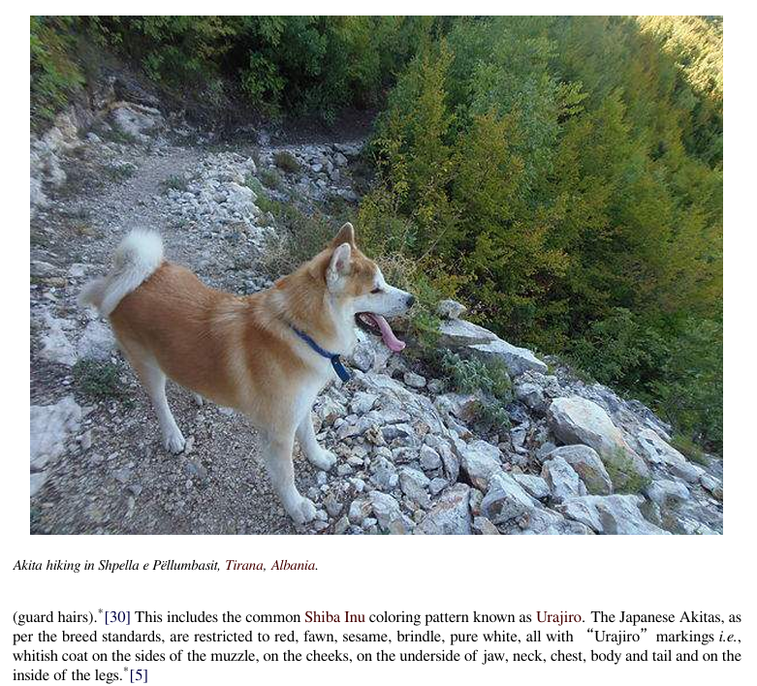
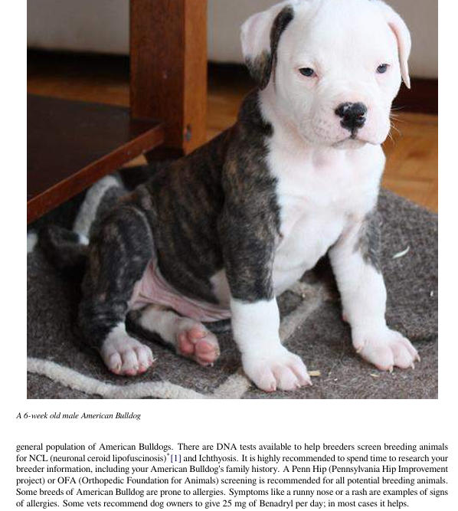
600 pages

Slide 4


Document
Loader
Text
Splitter
Text chunks
PDF
Loaded PDF
embedding model
Embeddings
Vector Database
embedding model
Retriever
+
Final output
user query
Embeddings
Semantic search
Result chunks + user query
LLM

Slide 5
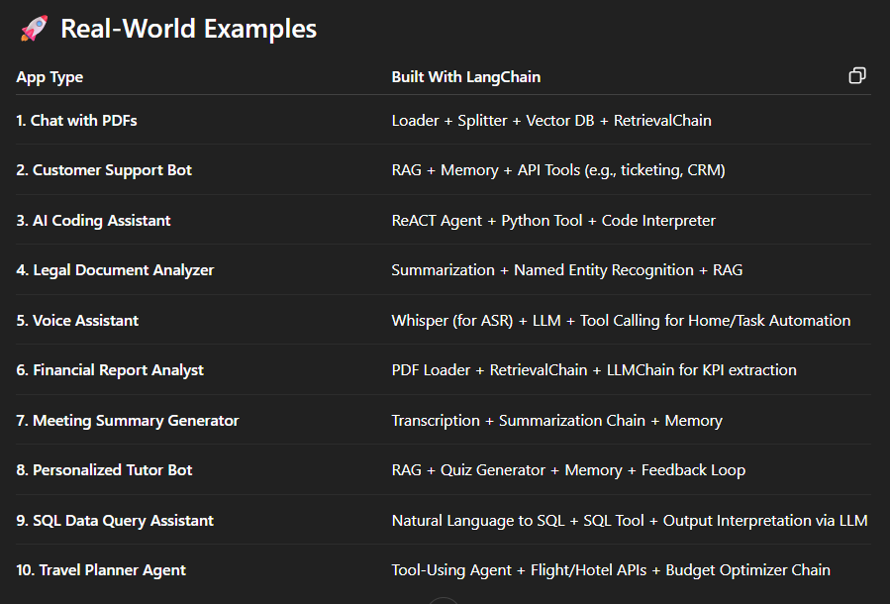
OPENAI API : https://platform.openai.com/settings/organization/api-keys

Slide 6
THANK YOU FOR YOUR TIME

